Slide 1

DATA WAREHOUSE IN BUSINESS
Data Warehouse Gives Complete Picture of a Business
By: Belal Khaled
ID: 2136873
1

Slide 2

Contents
4
5
6
Introduction
Data Warehousing: A Solution for Business Pain Points
Main Data Warehouse Characteristics
7
8
9
Database and Data Warehouse
Key Components of a Data Warehouse
Benefits of Data Warehousing
10
11
12
The Foundation of Data Warehouse
Data Warehouse Tools and Utilities
Examples of Well-Known Data Warehouses
2

Slide 3
Contents
13
14
15
Data Warehouse vs. Data Lake
Big Data and Data Warehousing
A Successful Data Warehousing Implementation
16
17
18
Opportunities for Tech Providers in Data Warehousing
Conclusion
References
Structure and Roles of PERT
3

Slide 4

INTRODUCTION
A data warehouse in business is a centralized system that stores and organizes large volumes of data from various sources.
It supports analysis, reporting, and decision-making by providing quick access to historical data, helping businesses identify trends and make informed decisions.
4

Slide 5
DATA WAREHOUSING: A SOLUTION FOR BUSINESS PAIN POINTS
It's a critical component of data warehouse business intelligence (BI) systems, providing a foundation for analysis, reporting, and decision-making.
Data Silos
Inefficient Reporting
By consolidating details from different systems, data warehouses break down silos and provide a unified view of the business.
hey streamline reporting processes by providing a centralized source for analysis, reducing the time and effort required to generate reports.
Poor Quality
Slow Decision Making
Data warehouse concepts improve quality by cleaning, standardizing, and validating data before it's stored.
By providing easy access, data warehouses enable organizations to make faster and more informed decisions.
Missed Opportunities
They uncover hidden trends and patterns leading to new business opportunities by analyzing data pipelines.
5

Slide 6
MAIN DATA WAREHOUSE CHARACTERISTICS
Data warehouses are organized around business subjects or dimensions.
Statistics is often normalized to reduce redundancy and improve data integrity.
The data warehouse integrates facts from various sources into a unified view.
Data warehouses maintain metadata.
Data warehouses store historical files, enabling analysis of trends and patterns over time.
Data warehouses are designed to handle large input volumes and can be scaled to accommodate growing needs.
The content of a data warehouse is typically not modified, preserving a historical record for analysis.
They are optimized for analytical queries, using techniques like indexing and partitioning to improve query performance.
Data warehouses are primarily read-only and optimized for analytical queries rather than frequent updates.
Data warehouses provide controlled access.
6

Slide 7
THE DIFFERENCE BETWEEN DATABASE AND DATA WAREHOUSE
Feature | Data Warehouse | Traditional Database
Purpose of Data Warehouse | Analytical processing | Transactional processing
Structure | Denormalized | Normalized
Queries | Complex, ad-hoc | Simple, ad-hoc
Data | Historical | Current and recent
Access | Primarily read-only | Frequent updates
Optimization | OLAP in the data warehouse (Online Analytical Processing) | OLTP (Online Transaction Processing)
Focus | Decision support, reporting | Operational efficiency
7
7

Slide 8
Key Components of a Data Warehouse
These components work together to store, manage, and process facts for analytical purposes in the main types of data warehouses.
Internal Data Sources
01
Transactional Systems
Operational Databases
Legacy Systems
Data Sources: The Foundation of Data Warehousing
External Data Sources
External Data Sources
02
Public Datasets
Third-Party Data Providers
The sources are the systems or applications that generate the stuff to be stored and analyzed. These sources can be internal or external.
Partners and Suppliers
8
8

Slide 9
Benefits of Data Warehousing
Improved accessibility
Enhanced Decision-Making
01
02
Transactional Systems
Data warehouses help you see the whole story of your business, not just snapshots.
Is a crucial benefit of data warehousing. It is the ability to quickly and easily access and retrieve it from the warehouse for analysis and reporting purposes.
Scalability and Performance
03
A data warehouse is a super-flexible, high-performance car. It can handle any road, any weather, and any speed. That's the beauty of scalability and performance in data warehousing.
9
9

Slide 10
The Foundation of Data Warehouse
Components of a Data Warehouse Architecture
Data warehouse architecture is the blueprint or design that outlines how a warehouse is structured and operates. It encompasses the various components, processes, and relationships that work together to store, manage, and retrieve information for analysis and reporting.
Traditional Architecture for Data Warehouse (Kimball)
The Kimball methodology, pioneered by Ralph Kimball, is a top-down approach that focuses on creating marts, which are smaller, focused subsets of a data warehouse.
01
Cloud Data Warehousing
It leverages data warehouse cloud computing infrastructure to store and process info. It offers scalable, flexible, and cost-effective solutions for organizations of all sizes.
02
Modern Data Warehouse Architecture (Inmon)
The Inmon methodology, developed by Bill Inmon, is a bottom-up approach that focuses on creating a centralized data warehouse before building data marts.
03
10
10

Slide 11
DATA WAREHOUSE TOOLS AND UTILITIES
Category | Tools | Description
ETL Tools | Python (with Pandas, NumPy, Scikit-learn), Spark (pyspark), AWS Glue, Airflow | Extract, transform, and load info into the data warehouse.
Data Modeling Tools | Python (with Pandas, NumPy, Scikit-learn), AWS Glue | Design and create data models, including dimensional and normalized models.
Data Integration Tools | Python (with Pandas, NumPy, Scikit-learn), Spark (pyspark), AWS Glue, Kafka | Integrate stuff from multiple sources, ensuring consistency and accuracy.
Data Quality Tools | Python (with Pandas, NumPy, Scikit-learn), AWS Glue, DataDog | Assess the quality, identify and correct errors, and improve integrity.
Data Warehousing Platforms | AWS Redshift, Data Warehouse Snowflake, Google BigQuery | Provide a foundation for building a data warehouse.
Data Visualization Tools | Power BI, Google Looker Studio, AWS Quicksight, Domo, Plotly, Grafana | Create interactive dashboards, charts, and reports to visualize details and uncover insights.
Data Governance Tools | Python (with Pandas, NumPy, Scikit-learn), AWS Glue, DataDog | Manage governance policies and ensure data quality, security, and compliance.
Data Lake Tools | AWS S3, Google Cloud Storage | Store and manage large volumes of raw material in a scalable and cost-effective way.
11

Slide 12






Examples of Well-Known Data Warehouses
Amazon Redshift for Data Warehouse
Microsoft Azure Data Warehouse
Google BigQuery
Amazon Redshift is a fully managed, petabyte-scale data warehouse service offered by Amazon Web Services (data warehouse AWS). It is optimized for business analytics by data warehouse and offers columnar storage, parallel processing, and automatic scaling.
Microsoft Azure SQL Data Warehouse is a cloud-based data warehouse service that leverages the power of SQL Server technology. It offers a fully managed, massively parallel processing (MPP) architecture for high-performance data warehouse analytics.
Google Data Warehouse BigQuery is a serverless service offered by the Google Cloud Platform. It is designed for large-scale data analyst work and supports SQL and Python queries. BigQuery offers automatic scaling and pay-as-you-go pricing.
Snowflake Data Warehouse
Microsoft Azure Synapse Analytics
Snowflake is a cloud-based data warehouse platform that offers a unique architecture with a separate compute and storage layer. This allows for independent scaling of resources. Snowflake is known for its performance, scalability, and ease of use. It supports SQL and Python queries and integration with other cloud platforms and tools.
Microsoft Azure Synapse Analytics is a unified analytics platform that combines data warehousing, data lake, and integration capabilities. It offers a serverless architecture and can handle both structured and unstructured files.
12
12

Slide 13
DATA WAREHOUSE VS. DATA LAKE
Approaches | Data Warehouse | Data Lake
Concept | A centralized repository that integrates structured, cleansed, and transformed data from multiple sources | A centralized repository that stores raw, unstructured, semi-structured, and structured data in its original format
Data Storage | Structured data following a predefined schema to facilitate efficient querying and analysis | Diverse data types: text files, documents, images, videos, logs, sensor data
Data Structure | Enforcing a structured schema design, ensuring data consistency and integrity | Lack of predefined schema or data organization, allowing flexibility for exploration and experimentation
Data Transformation | ETL process: data is extracted, cleaned, and transformed before being loaded into the warehouse | Schema enforcement occurs when data is extracted from the lake for analysis
Scalability | Handling structured data and offering vertical scalability by scaling up resources | Handling massive volumes of data and providing horizontal scalability
Data Processing | Supporting SQL-based querying and reporting tools for analytics purposes | Supporting various frameworks (Apache Hadoop, Apache Spark) to perform distributed data processing and analytics
13
13

Slide 14
BIG DATA AND DATA WAREHOUSING
Big data is the powerhouse, collecting and storing tons of raw material from everywhere.
Data warehousing is the organizer. It takes it all and makes sense like a smart assistant who knows how to file everything neatly.
Together, they're unstoppable. Big data provides the material, and data warehousing makes it valuable. They help businesses make better decisions and understand their customers better than ever before.
Relationship Between Data Warehouse and Big Data Analytics:
Data warehouses and big data analytics are closely related but serve different purposes. Schedule a call to complement reality with a profitable solution.
What is the difference?
A data warehouse stores structured data collected, cleaned, and transformed for analysis. It is typically used for business intelligence and reporting applications and is designed to support complex queries and analysis of historical data.
In contrast, big data analytics involves processing and analyzing large volumes of unstructured or semi-structured data to extract insights and trends.
Two benefits:
1. Data warehouses can produce a single source of truth for the data used in big data analytics.
2. Data warehouse produces a structured environment for big data analytics.
14
14

Slide 15
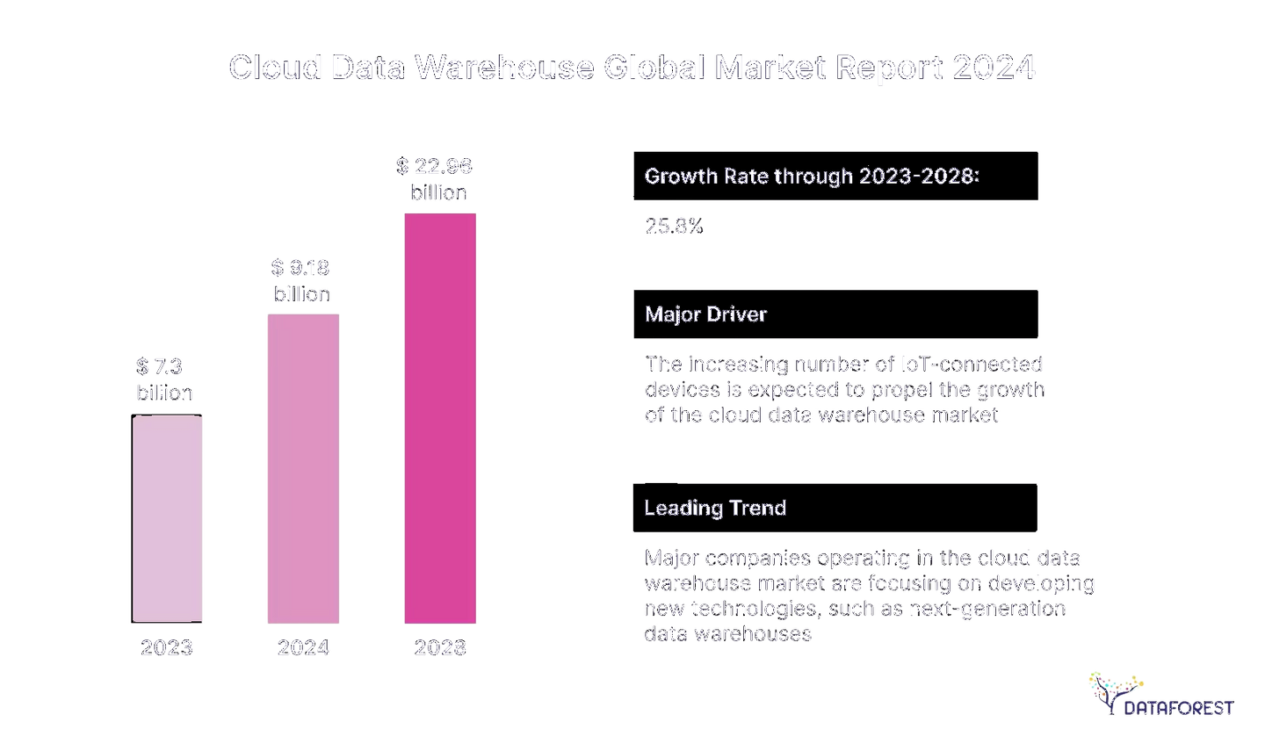

A SUCCESSFUL DATA WAREHOUSING IMPLEMENTATION
It addresses the organization's specific challenges or opportunities and enables users to uncover valuable insights.
A successful data warehousing implementation empowers decision-makers to make informed choices based on data-driven evidence.
It handles future growth and changes in business data warehouse requirements and justifies the investment by generating tangible advantages of data warehouse, such as increased efficiency, improved customer satisfaction, or competitive advantage.
15
15

Slide 16
OPPORTUNITIES FOR TECH PROVIDERS IN DATA WAREHOUSING
Data warehousing is a goldmine for tech providers like DATAFOREST.
There's a ton of opportunity to create tools and services that help businesses dig for valuable insights.
A data warehouse makes it easy for companies to store and analyze their info and take a sense of it.
We develop fancy tools to visualize reports and protect them from hackers.
It also lets us tailor solutions to the needs of different businesses.
16

Slide 17



A data warehouse is a centralized repository that stores historical files from various sources optimized for analysis and reporting. It provides a comprehensive view of an organization's staff, enabling informed decision-making.
Data warehousing can be more expensive than other management approaches, such as data lakes,
A data warehouse allows an organization to achieve enhanced decision-making, improved efficiency, a competitive advantage, and other tangible benefits. By providing a centralized repository of historical facts for analysis and reporting, data warehouses enable organizations to make more informed decisions, optimize operations, and gain valuable insights.
Conclusion
Advantages: Data warehouses provide a centralized view, improving decision-making and efficiency. They can also help uncover hidden trends and patterns.
Disadvantages: Data warehouses can be expensive to implement and maintain and may require specialized skills and expertise. Quality issues can impact the accuracy and reliability of the data stored in a warehouse.
17
17

Slide 18

References
https://dataforest.ai/blog/data-warehouse-concepts-building-a-library
https://dataforest.ai/blog/data-warehouse-and-data-lake-folded-papers-vs-cluttered-desk
https://dataforest.ai/blog/big-data-analytics-data-warehouse-more-informed-decisions
https://blog.tbrc.info/2024/05/cloud-data-warehouse-market-share/
18

Slide 19
THANK YOU
19

